Slide 1
Flow chat for mask detection
BY
MUTHUKUMARAN

Slide 2
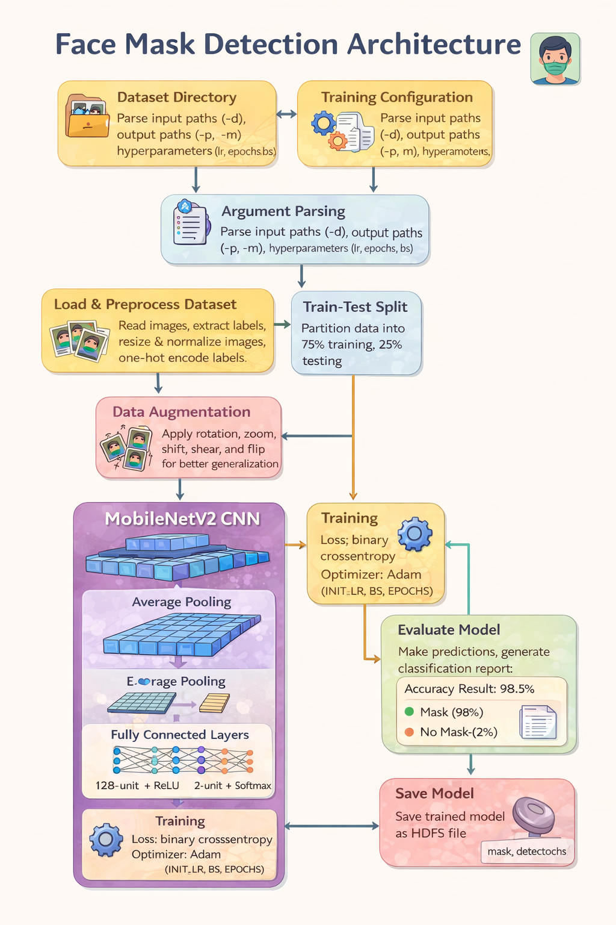
Image of mask

Slide 3
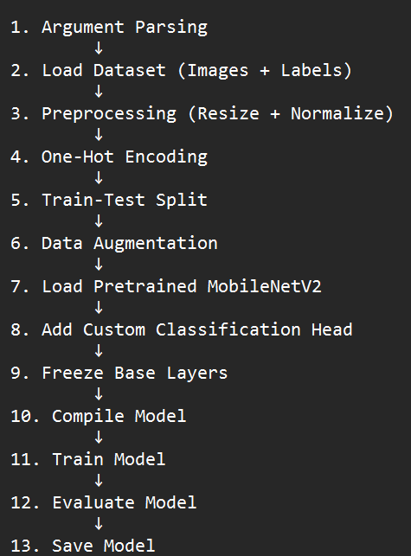
1.Overall Architecture of Your Face Mask Detection System

Slide 4
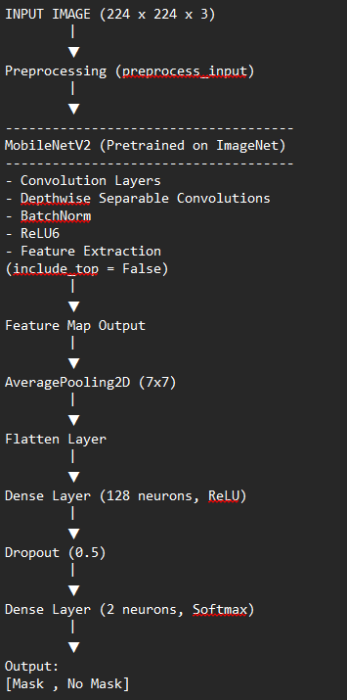
2. Layer-Wise Deep Learning Architecture Diagram

Slide 5
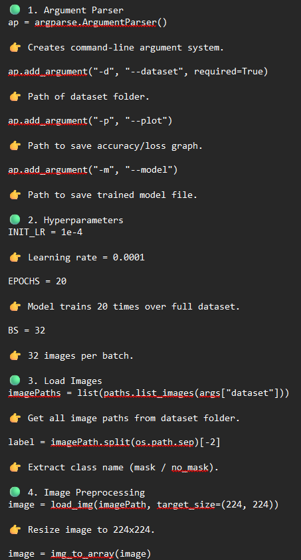
3.Easy Explanation of Each Code Block

Slide 6
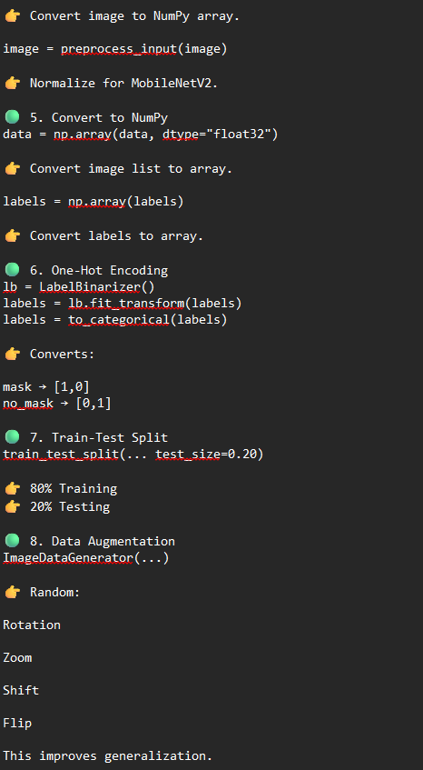

Slide 7
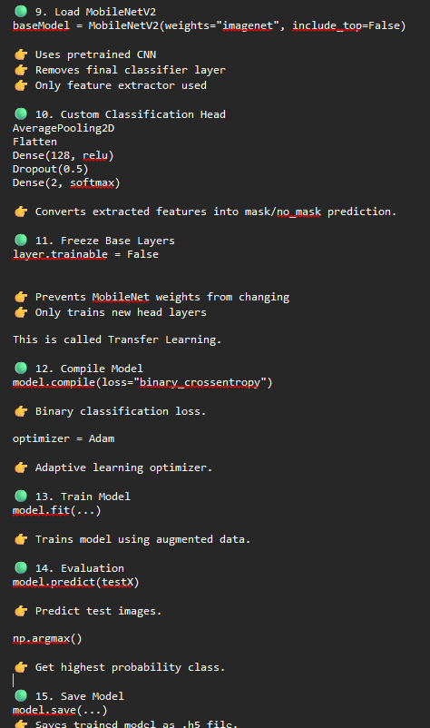

Slide 8
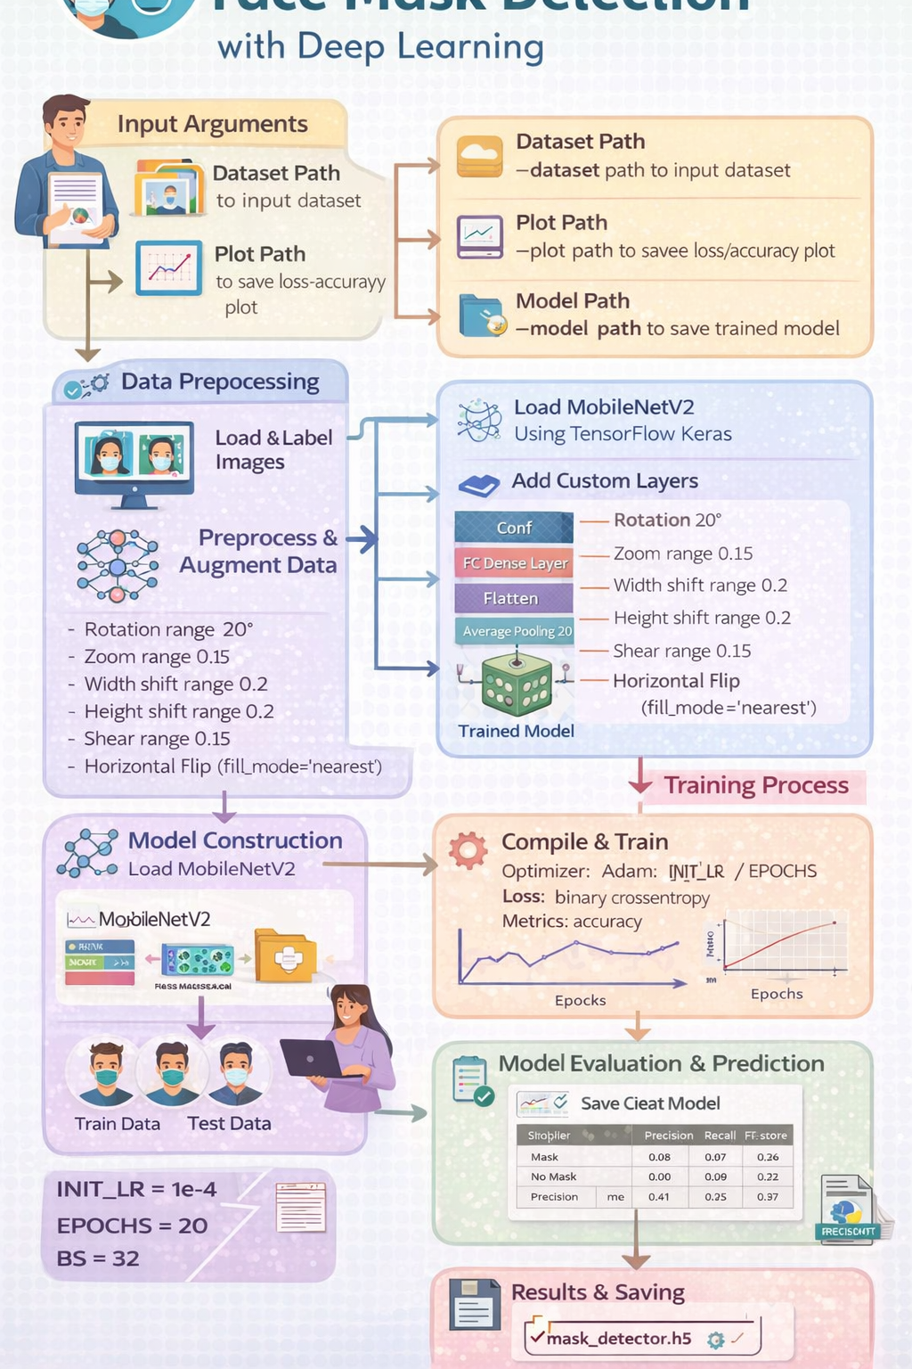

Slide 9
Thank
you…..

